Slide 1
Writing a proposal
Research Skills and methods

Slide 2
Proposal Writing –
A proposal is a request for approval to conduct research.

Slide 3
Proposal Formatting
Formatting is concerned with the look, style, and layout
of the proposal.
A properly formatted proposal consists of the following benefits:
Adds to the perception that the document is well thought out.
Enhances the credibility and professionalism of your organization.
Facilitates the understanding of the proposal content.
Makes it easy for the reader to find the information they are looking for.

Slide 4
Proposal Formatting
Length: The length(ie. Number of pages) will usually depend on the amount of resources required to conduct research.
Lay out: The margins, spacing, fonts, headings, and numbering should be consistent throughout the document.
Writing: Sentence structure, grammar, and spelling should be checked.
Footnoting & References: footnote contains source of quotes, statistics, and tables. Reference describes all sources of information used in the preparation of the document.

Slide 5
Proposal structure
Title Page:
Declaration
Table of Contents:
Back ground
Problem statement
Proposed solution
Objectives
Research questions/hypothesis
Significance of study
Literature review
Research methodology
Budget and resources
Research schedule
References

Slide 6
1. Title page
The first page of the proposal and often serves as the cover of the document.
It should include:
  Project title,
  Project location,
  Names of researcher and organization;
  date,
  any other required information
  (e.g. Names of supervisor,registration Number ,Name of the course/qualification towards which the contributes
  NB: Title page has no page number
  The title should be centered

Slide 7

Sample Title page

Slide 8
2. Declaration
The second page should contain a declaration on originality of work
It Should include:
  1. researchers’ and supervisor’s declaration
  2. researchers’ signature and dates.
  NB: Declaration page should be given first page number
  It should be written roman number format
  e.g (i)

Slide 9

Declaration
Example

Slide 10
3. Table of contents
This section consists of :
A list of topics contained in proposal document
Topics titles should be in capitals and bold.
The subheadings should follow each chapter title and should be in title case.
Each heading should be listed with its corresponding page number.
Appendices are used to avoid crowding the body of proposal document and maintain the narrative flow.
Usually appendices heavy content such as code list, questionaires,engineering drawings, and letters of support.

Slide 11
1.0 Back ground
Provide brief history about project research area/organization (e.g origin,founder,starting year, following years etc).
Discuss about the global perspective followed by the local scenario. (e.g global trends of phenomena, then in trends in africa,kenya and then nairobi county)
Explains the target group/client/participants/respondent) in the study.(e.g varsity students,staff etc)
It should be clear on what activities or business the target group / client is involved in and how operations are currently conducted.
It sets the stage for the problem statement by highlighting the origin of the problem

Slide 12
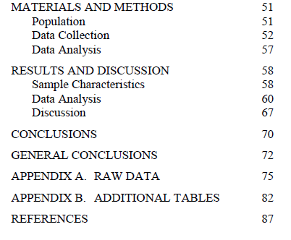
Sample table of contents

Slide 13
Problem statement
Refers to statement that describe exactly what problem is addressed by the research.
Indicate why(reason) and how(impact) it is a problem.
Give information to support this e.g. by use of statistics or evidence.
This should be derived from background information to illustrate connectivity.
Problem statements can be more than one. Each per paragraph.
Each problem should be stated clearly with a brief explanation on how it arises from the functions being undertaken by the organization.

Slide 14
Problem statement Sample
Some of the university students in African based universities do not own personal computers. Consequently, they are forced to access E-learning materials at fixed locations where there is computers with internet connectivity. This eliminates flexibility of accessing E-learning content.
E-readiness survey conducted by, Kashorda and waema(2009) observed that personal Computers ratios to students in E.A universities were less than 10:100. and about 25% of students were mainly accessing computers at home while about 50% of the total number of students, were accessing computers in cyber cafés.

Slide 15
Proposed solution
This is a high level description of the proposed system or the main objective to be achieved by the study.
It gives a specific & accurate summary of the overall aim for conducting the study
It is also known as purpose statement, since
The statement should be in line (consistent) with the title.

Slide 16
Proposed solution
Example1:
We therefore propose to conduct a study aims establishing penetration of mobile devices in higher learning institutions (e.g universities) and find out benefits that can be obtained from using such devices to access E-learning content instead of computers.

Slide 17
Proposed solution
Example2:
“The purpose of the study is to understand the role of change management or the lack of it in determining the success or failure of ERP systems(projects) implementation in public sector organizations using case study method. ”.

Slide 18
Specific objectives
Specific objectives refers to sub- statements derived from of the main objective statement
They are therefore related to the main objective.
have to be in line with the variables the candidates hypothesis to influence the phenomenon being investigated.
Should not be questions in the questionnaire.
Specific objectives should be short and measurable since hey are the basis upon which the success of the project will be evaluated.
Therefore they should basically address each of the problems being faced by the organization.
Specific objective statements starts with ‘To’

Slide 19
Specific objectives
Example of specific objectives
1. To establishing penetration of mobile devices in higher learning institutions such as universities.
3. To find out how such devices can be used by students to access E-learning content.
2. To identify potential benefits of using mobile devices for accessing E-learning content instead of computers.

Slide 20
Specific objectives
Example of specific objectives
To study the project management system employed in implementation of ERP systems
To investigate interests and the levels of support of the key stakeholders
To understand project management system
To study the skills and experiences of the key ERP system team members.

Slide 21
Research Questions
They should be in line with the specific objectives and equal in number.
Have to be numbered (1, 2, 3…..) and should be questions and not statements.
Research questions example:
Which project management system that is employed in implementation of ERP systems?
What are the interests and the levels of support of the key stakeholders?
What is project management system?
What are the skills and experiences of the key ERP system team members?.

Slide 22
Examples of research questions
1. on average how long does it take to process each case at the entry gate of KCA University?
2. which biometric technology that has been implemnented at entry Gate of kca university?
3. what is the performance of the implemented biometric technology compared with other related biometric technologies (e.g in terms of processing time)?
4. what are the possible implementation issues that are likely to be causing processing delay at kcau point of entry(e.g server related issues)?

Slide 23
Significant of the study
It also known as justification of the study
This section describes the benefits of conducting the research and whom it shall benefit.
Examples:
1. the study results can be used by university administration to determine whether it is worth investing on biometric technology.
2. Results can be used by other researchers to identify causes of delays in biometric technologies so that they can research for possible delay solutions.

Slide 24
Literature review
literature review has the following importances:
1. Provide the reader with an understanding of the current academic debate surrounding the topic under focus( e.g latest conference or journal paper)
2. Draws attention to the major issues(e.g Delay) and questions in the field.
3. It helps the writer to define and narrow down the research
area by examining the research of other authors
4. Enables the researcher to determine whether there is anything new to contribute to the debate.

Slide 25
Literature review
Literature review consists of the following content
1. Related work: Discussion on what other researchers have done within a broad field of interest .e.g. E.g Biometric technology.
3. Knowledge gaps: discussion on research possibilities that have been overlooked or problems(missing information) that have not been addressed by researchers.
4. Closed lines of inquiry : discussion to previous approaches that produced fruitless results.
5. New lines of inquiry: Provides insight on emerging technologies and topics related to area of study. e.g cloud computing, ambient intelligent technologies
NB: Cite references in the text using APA or Harvard method of citation.

Slide 26
Literature review
6. Variables mentioned in specific objectives should be subheadings of the literature review to form the basis for analysis.
e.g Type of biometric technologies, Processing times
7. Citations: credentials of where information was obtained from.
Examples:
According to Tudge and Rogoff(1989), Piagetian theory advocates peer-to-peer interaction .
Particular types of intellectual stimulation have also been suggested to arise from working with peers (Crook, 1994).

Slide 27
Research methodology
Research methodology is an outline of the plan of action.
It consists of the following sections:
1. Research design : Type of research for guiding data collection and reasons for selecting by citing. e.g quantit
2. Development methodology: Method that will be used to develop proposed system if applicable. e.g. Prototyping,enhanced waterfall,spiral etc.
3. Target Population: group of people (i.e respondents,interviewees,partipants) from which data will be collected and reasons for selecting it. e.g students, executive leaders, managers, front line employees etc.
4. Sample design: details about sample size, sampling technique and reasons for selecting both size and that technique.

Slide 28
Research methodology
5. Data collection Instruments: Tools that will be used to collect data and reasons for selecting them e.g Questionnaires, interview recorders(i.e video or voice recorder) etc.
6. Data Processing and analysis: statistical Techniques that will be used to analyse data and reasons for selecting them e.g T-test, correlation, skeweness, normal distribution test, measures of central tendency(mean,mode,median)

Slide 29
Budget and resources
This section should generally address all the resources that will enable data collection,analysis and development of the system to succeed.
The key items include data collection instruments,data analysis softwares,hardware, human capacity to be hired and transport costs and any other costs that will be incurred.
Usually budget and resources are presented in table

Slide 30
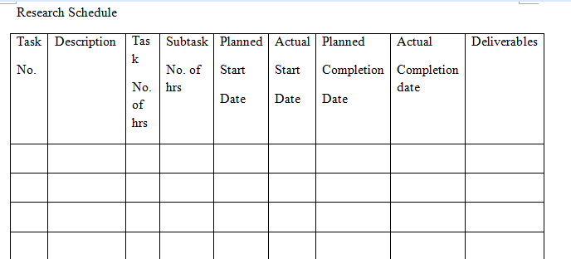
Research schedule
Project schedule is a breakdown of all the tasks that will be carried out in the course of carrying the project.
It consists an estimate of the duration and dates of each task
Usually it is presented in form of Gantt chart or table
Example

Slide 31
References
References sections contains sources of your information
It only include material that is relevant to the research and has been cited in the document.
Examples:
Tudge, J. and Rogoff, B. (1989) Peer Influences on Cognitive Development: Piagetian and Vygotskian Perspectives. In (eds) M. Bornstein and J. Bruner Interaction in Human Development. Lawrence Erlbaum Associates.
Crook, C.K. (1994) Computers and the collaborative experience of learning. London: Routledge

Slide 32
Exercise
Form a group four members and formulate a research Idea
Write a brief (max. 2 pages) of your research idea , including:
  i. Statement of the problem
  ii. Why choice of topic and problem
  iii. Purpose statement (proposed solution)
  iv. Specific objectives
3. Present the project brief in the next lecture

Slide 33
Reference
Use the following link to access an example of research website:
http://cbalgroup.wordpress.com/

